Slide 1

Water quality monitoring
North Coast Watershed Association
Kelli Daffron, Project Manager

Slide 2
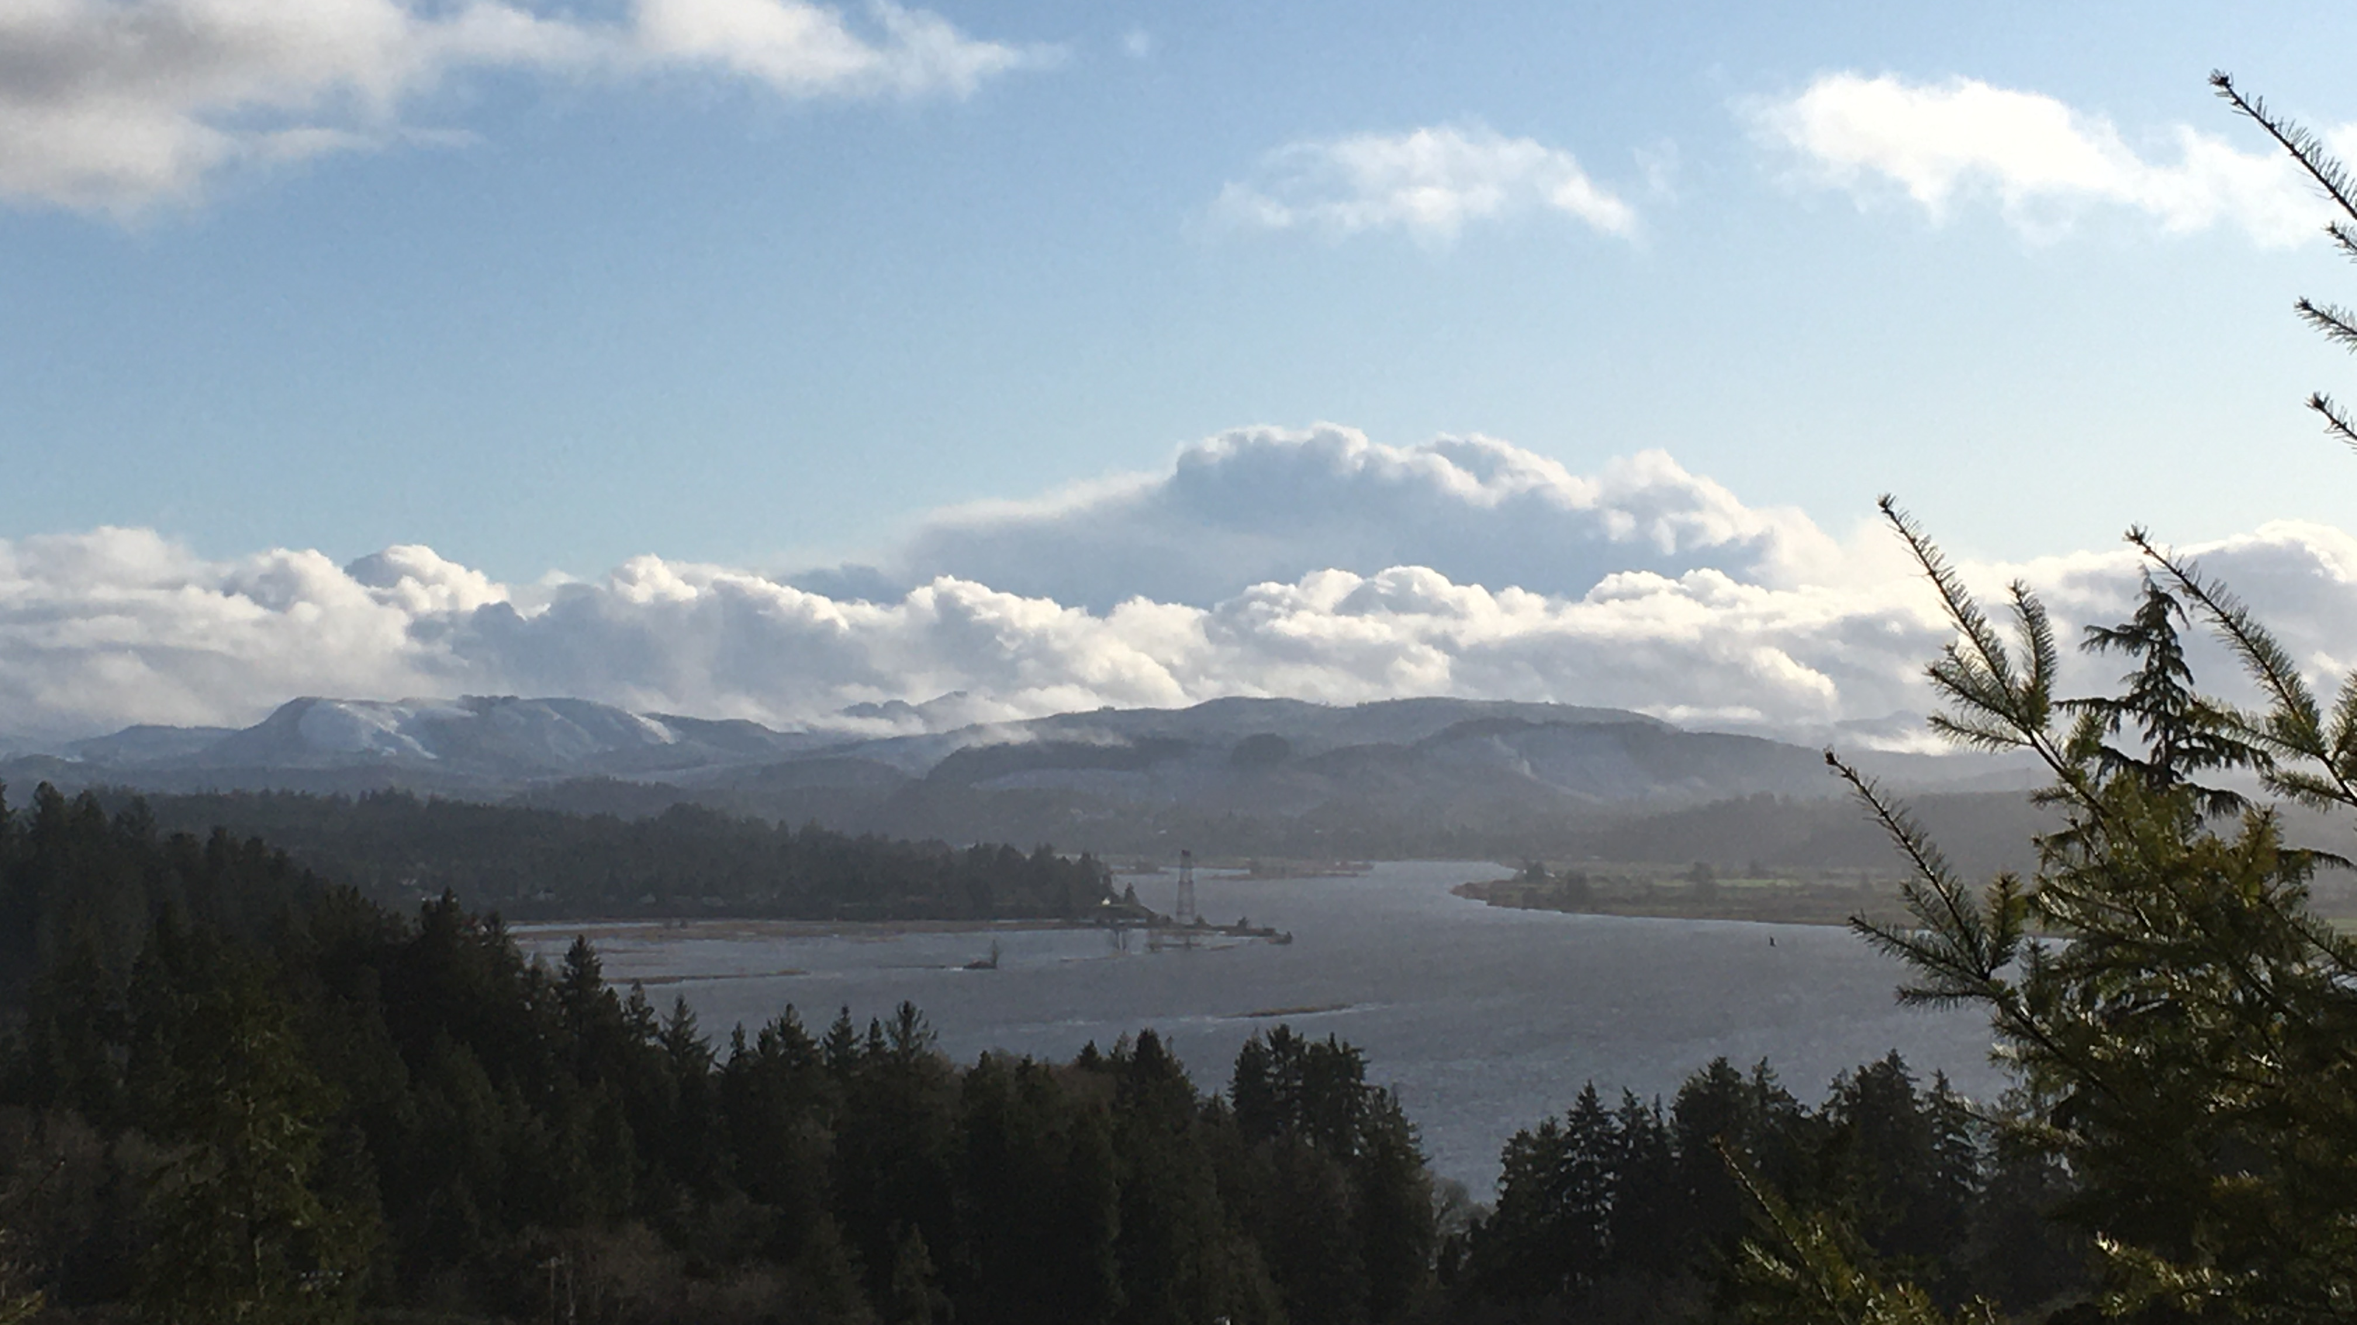
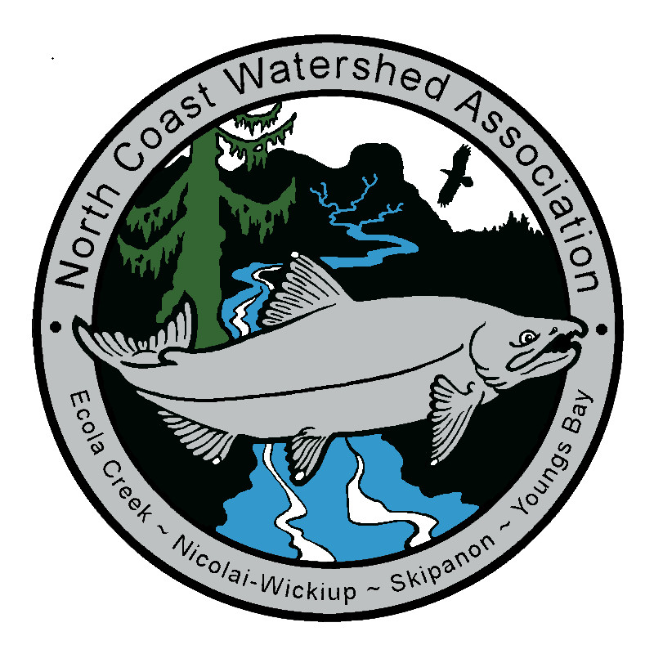
North Coast Watershed Association
501 c3 created in 2001 to address significant declines in native steelhead and salmon runs
Service area includes the Youngs Bay, Nikolai-Wikiup, Skipanon, and Ecola watersheds
Board members currently include community members, land managers, forestry folks, and representatives from the timber industry as well as other environmental non-profits
  Our projects are guided by the communities we serve, approved by the board of directors, and funded by grants
Oregon Watershed Enhancement Board (OWEB), a state agency largely funded by lottery dollars, funds much of our work
Oregon Department of Environmental Quality (DEQ) does quality control of our water quality monitoring program

Slide 3
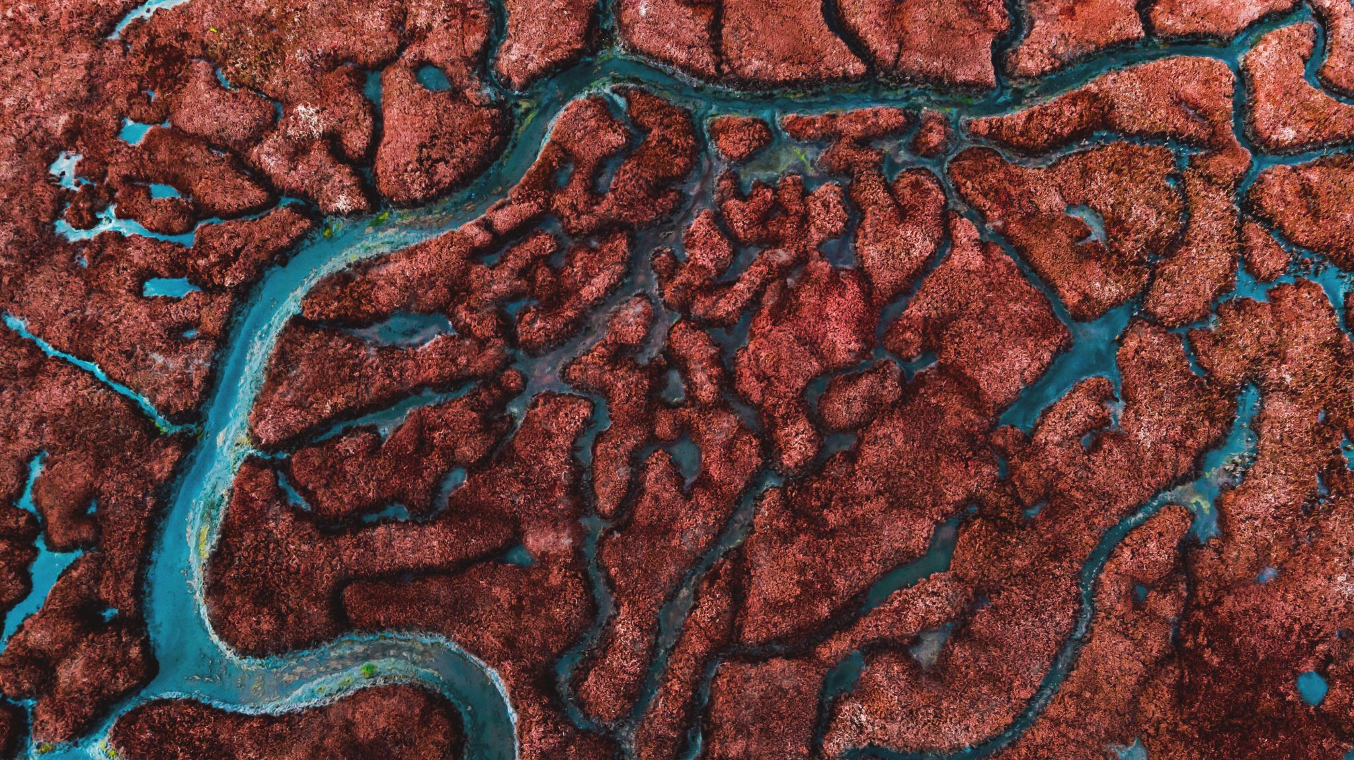
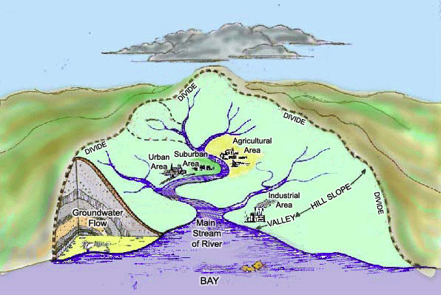
What is a Watershed?
Area of land where all water drains into one major water body
Determined by topography
Includes:
  Groundwater
  Rivers/streams
  Rain/runoff
  Sewers/municipal/industrial outputs
What watershed do you live in?
Gif credit: Alice Ferguson Foundation
https://fergusonfoundation.org/btw-students/what-is-a-watershed/

Slide 4

Aspects of Water Quality
Turbidity
  Affected by erosion
pH
  Affected by wastewater, agricultural runoff, industrial/municipal practices, temperature
Dissolved oxygen
  Affected by water flow, algal blooms, oxygen-consuming organisms, temperature
Bacteria/microbes
  Affected by wastewater, agricultural runoff, industrial/municipal practices
Chemicals
  Pesticides, herbicides, fertilizers, cleaning products, medications, industrial wastes, etc.
Flow/Water Quantity
  Affected by climate change, tree cover, water use
Temperature
  Affected by climate change, tree cover, rate of flow
  Different standards for salmon spawning and rearing

Slide 5
NCWA Water Quality Program:
Temperature
2016
Initial 9 sites on the Lewis & Clark (3), Wallooskee (2), Klaskanine (2), Youngs (1) and Skipanon (1) Rivers
3 tidal, temporary sites
2017
5 sites added in Ecola Creek (2), Klaskanine River (2), and Cullaby Creek (1)
2018
8 sites added in Little (2) and Big (2) Creeks, Little Bear (1) and Bear (2) Creeks, and another on the Klaskanine River (1)
2019
Continued monitoring 22 established sites
2020
Updated Sample & Analysis Plan
Preliminary trend analysis

Slide 6
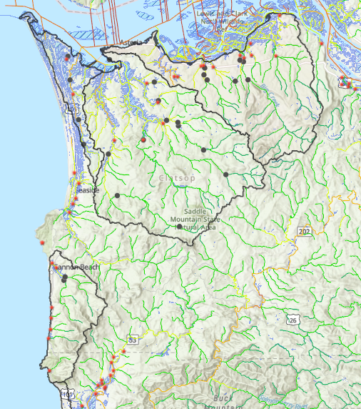
Current Logger Sites
NCWA service area outlined
Black dots represent our logger sites
Red stars represent head-of-tide
Blue shading is wetlands
Streams color coded using NorWeST aggregate temperature data from blue (coldest) to red (hottest)

Slide 7
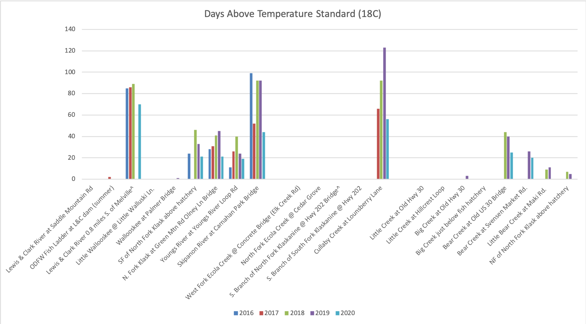

Slide 8
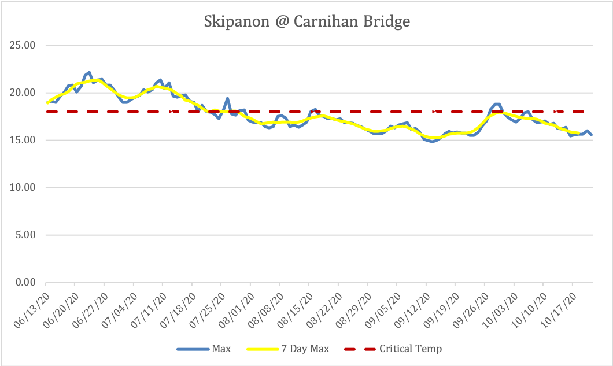
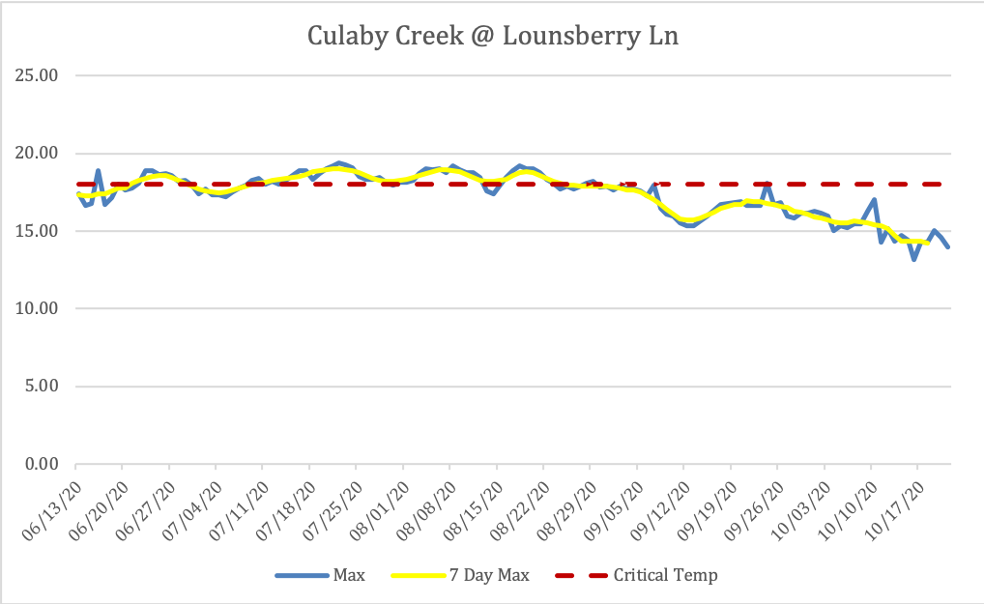
Skipanon Watershed Areas of Concern
Skipanon River site > 80 days above 18℃ for 3 out of 5 years of monitoring; > 40 days above standard for all 5 years.
Cullaby Creek site > 50 days above 18℃ for all 4 years of monitoring

Slide 9
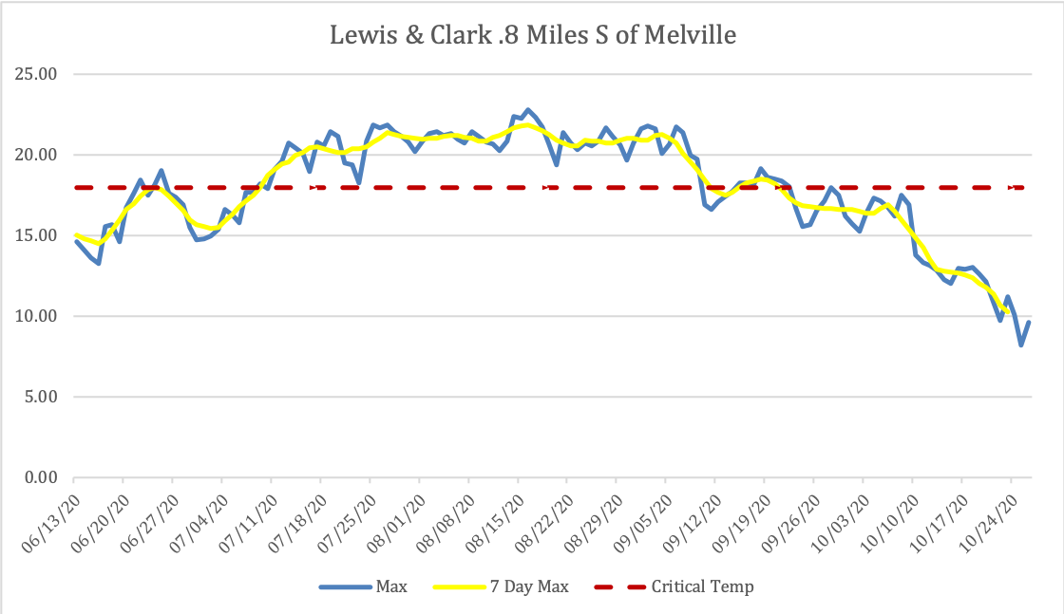
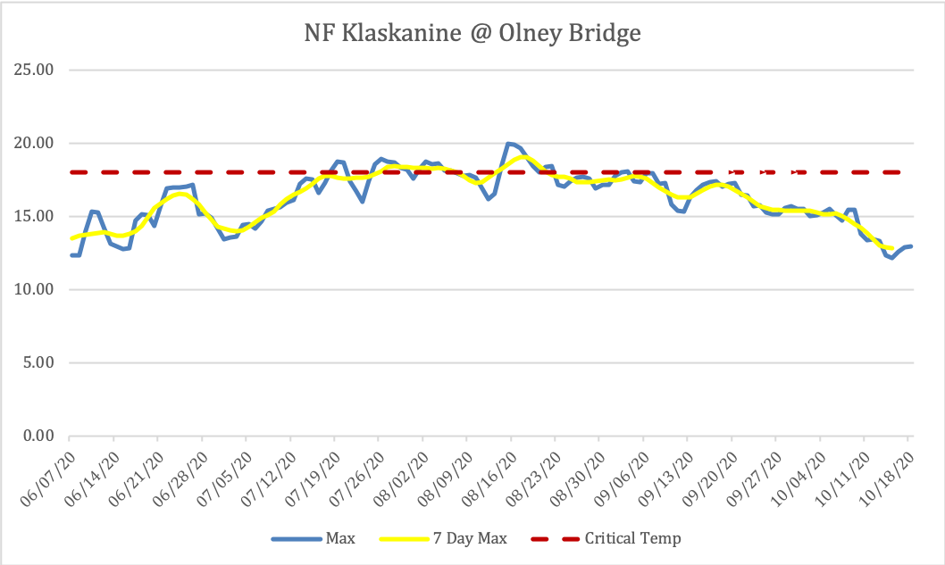
Youngs Bay Watershed Areas of Concern
L&C .8 Miles S of Melville site > 60 days above 18℃ for 4 years of monitoring
  Logger lost in 2019
NF Klaskanine site > 20 days above 18℃ for all 5 years of monitoring
  South Branch of NF Klaskanine above the hatchery has similar numbers

Slide 10
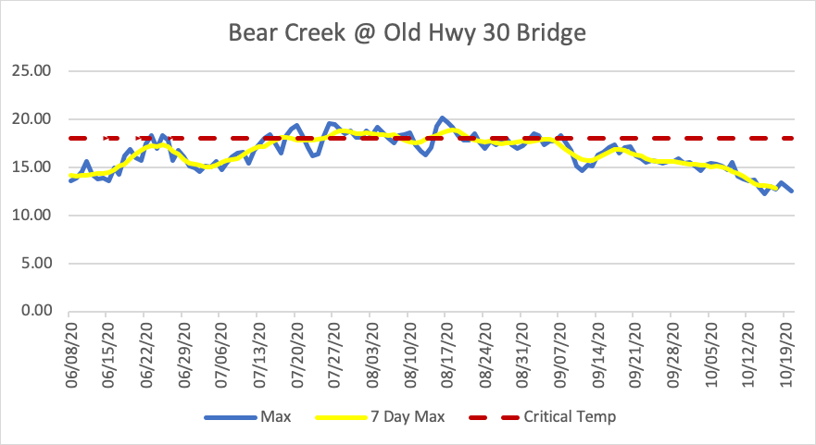
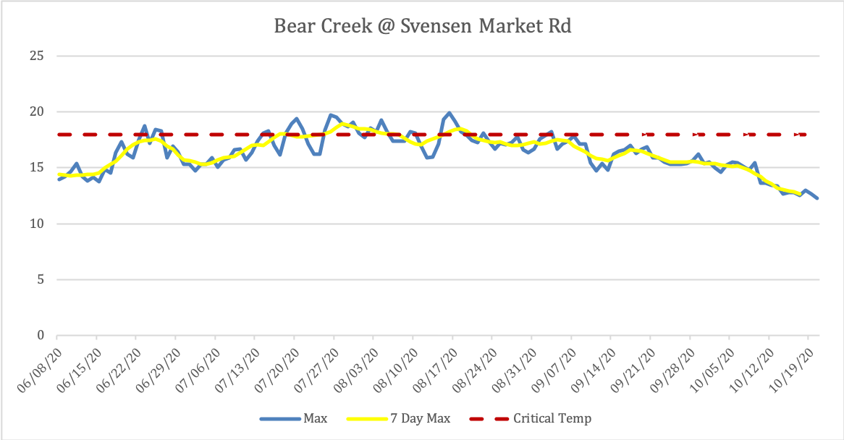
Nicolai-Wikiup Watershed Areas of Concern
Bear Creek at Old Hwy 30 site > 20 days above 18 ℃ for all 3 years of monitoring
Bear Creek at Svensen Market Road site > 20 days above 18 ℃ for 2 years of monitoring
  Logger lost in 2018

Slide 11
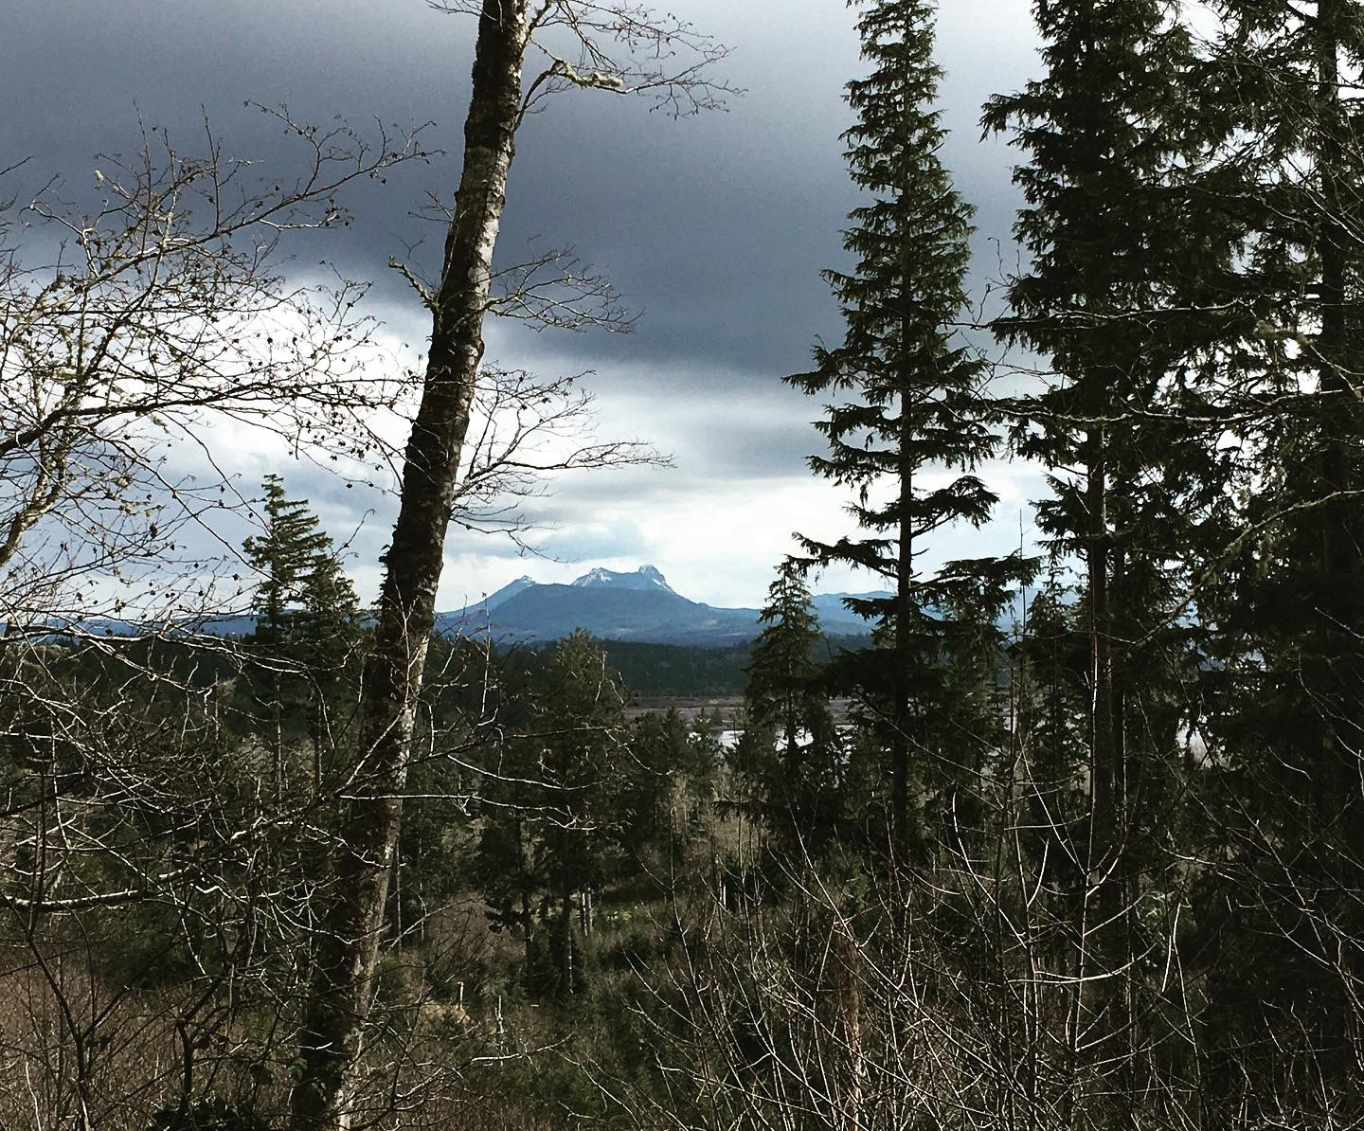
Project Expansion
Lewis & Clark River stream gauge to establish baseline flow
Backyard habitat program to encourage smart water use
Data sharing to inform future projects and policy
Map-building (GIS) to determine needs for future projects

Slide 12
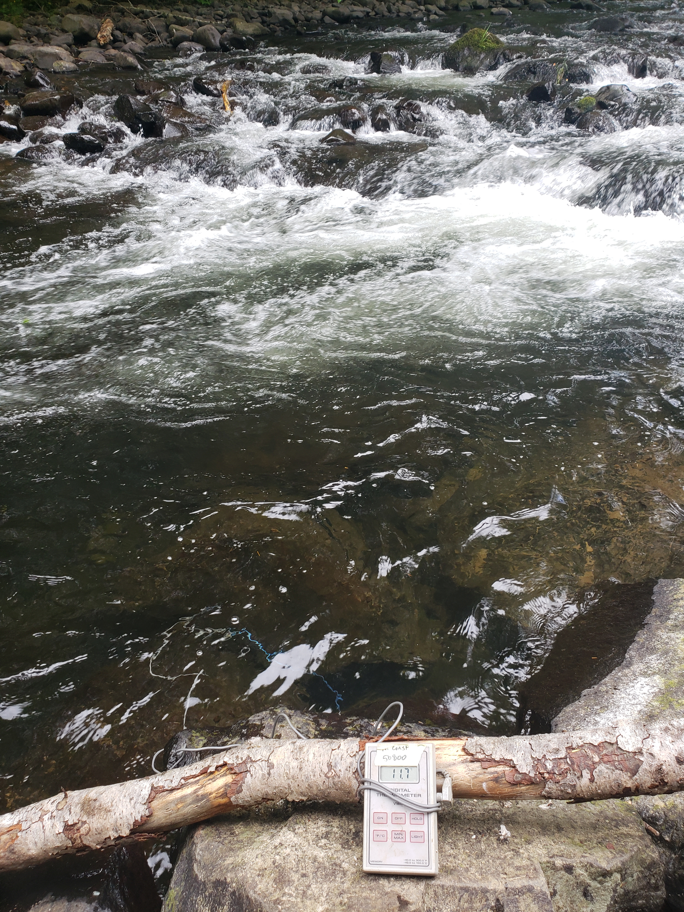
What can we do?
Plant trees/shrubs for shade and bank stability
Add Large Woody Debris (LWD) to slow flow, create deep pools, and trap sediments
Storm water management
Wastewater management
Upland forest management
Volunteer!

